Slide 1
Antique Auction
Furniture List

Slide 2
Items for Auction
Furniture Item | Year | Starting Bid
Iron Rod Bed | 1840 | $1,299.00
Victorian Sofa | 1920 | $1,499.00
Claw Foot Bathtub | 1910 | $1,799.00
Dining Table Set | 1870 | $1,899.00
Wardrobe | 1855 | $2,099.00
Rocking Chair | 1900 | $1,799.00
Wood Stove/Oven | 1910 | $1,999.00
Ice Box | 1890 | $2,299.00
Sleigh Bed | 1880 | $2,399.00
Roll-top Desk | 1920 | $2,599.00
Our goal is to provide a selection of antique furniture of the highest quality.
Our offerings include insurance and packing. You pay for shipping to your location.

Slide 3








Lighting Items
We will also offer a selection of lanterns, lamps, and other light fixtures.

Slide 4
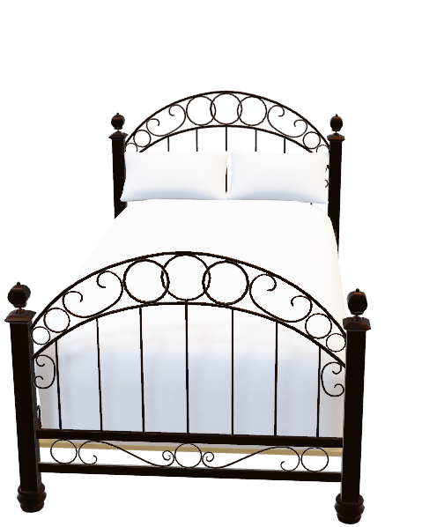
Antique Iron Rod Bed

Slide 5
How to Purchase at Auction
Submit Bid
3 days to bid
Bids may be changed until closed
Choose Shipping
Winning bidders notified by email
2 days to select shipping method
Complete Payment
Payment due within 2 days of notification
VISA, Mastercard, American Express

Slide 6
Advertising
Internet
Email Campaign
Magazine
Travel Agencies
Any other suggestions?

